Slide 1
Git
By
Learning In Urdu (learninginurdu.pk)

Slide 2
Find us online
http://learninginurdu.pk/
https://www.facebook.com/LearningInUrduCentre/
https://www.youtube.com/c/LearnInUrdu139
Twitter: @learninurdu139

Slide 3
Agenda
Version Management
Version Control Systems
Introduction to git
How you work with git
Installation of git
DEMO of using git
DEMO of Branching in git
DEMOs of Remote Repositories

Slide 4
What is Version Management?
We all manage different versions of our files e.g. By creating copy of the file/folder and appending timestamp or numbers
In case something goes wrong, we dump the current version and use the last stable version
Cons:
Takes extra space
Hard to find changes between different versions
Hard to manage/merge changes if multiple people are working on same files/folders on their machines
What about backup?
Notes:
https://developer.chrome.com/extensions

Slide 5
Version Control System/Software
Manage different versions (snapshots) of your content
Provide option to see differentials
Change Tracking (Who made which change and when)
Help you in merging the changes if multiple people are working
It may allow you to store all changes + change history on some server. No need to worry if you lose your local content.
Other names
Version Management Software
Source Code versioning
Source Control Management (SCM)

Slide 6
Version Control System (cont…)
Local
Example: RCS
Centralized
A Server – Client Model
One user can work on an item by “locking” the item on server.
Change tracking/history is mainly done on server.
Examples: SVN (Subversion), TFS
Distributed
Each person works on its own local copy (as it is working on main repository). Changes are merged later. Server may also be used.
Examples: Git, Mercurial

Slide 7
Introduction to “git”
Distributed Version Control System
Free & Open Source
Primarily used for source code management but it can be used for any sets of files.
Created by Linus Torvalds in 2005.
Command line tool
Major Design Goals
Distributed
Performance
Data Integrity

Slide 8
How you work with Git?
Step 1: Create Repository
Working directory
Step 2: Make Some changes
Add/Edit/Delete files etc.
Step 3: Move your changes to “Staging”
Changes become track-able
Step 4: Create Snapshot of your “Staged” Changes by “Commit”
Step 5: Repeat from Step 2

Slide 9
Installation of Git
Install Git
https://git-scm.com/downloads
It will install Git + Git UI + Git Bash
Tools For Better UI
TortoiseGit
SourceTree

Slide 10
Demo of Git Bash
Set Email & Author Name
git config --global user.email <email>
git config --global user.name <name>
Creating Repository
git init <name>
Move changes to “Staging”
git add <filename>
git add .
git add *.txt
Move changes from “Staging” to “Commit”
git commit –m ‘<comments>’
Move changes directly to “Commit"
git commit –a –m ‘<comments>’
It will consider only modified/deleted files, not newly added files.

Slide 11
Demo of Git Bash
Remove latest Commit from Tree
git reset --hard HEAD^
Move a file from “Staging” to untracked/working directory
git reset HEAD <file>
To discard changes in working directory (Undo)
git checkout --<file>
Show detail of a commit
git show <commit>
git show <commit> --stat
To ignore different files from tracking
touch .gitingore
Checking current status of repository
git status
Check commit history
git log

Slide 12
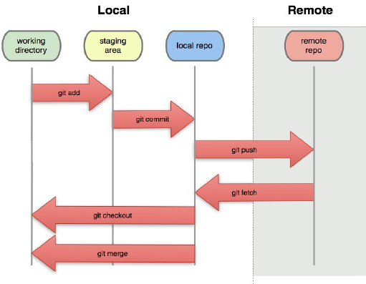

Slide 13
Branching
When you create a Repository, default branch (“master”) is created.
A branch is a “Pointer”
A branch refers to the development tree.
You may create many branches
A “commit” is a node which has a pointer to previous commit/s.
When you make a new commit, branch pointer starts pointing to new commit node.
“commit” node also contains pointers to the changes.
HEAD is a pointer which points to active branch.

Slide 14
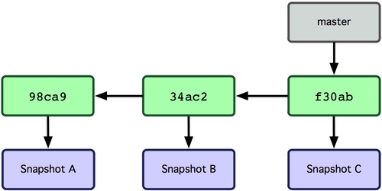
Three commits with master branch
Notes:
https://git-scm.com/book/en/v1/Git-Branching-What-a-Branch-Is

Slide 15
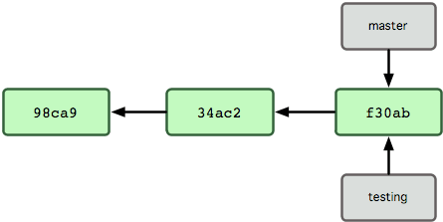
A new branch “testing” is created

Slide 16
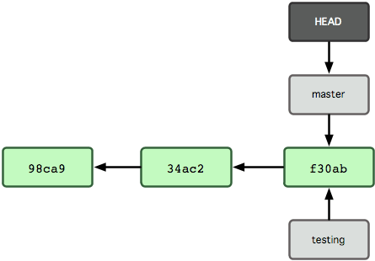
Active branch is “master”

Slide 17
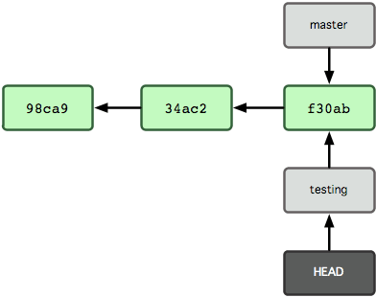
Active branch is “testing”

Slide 18
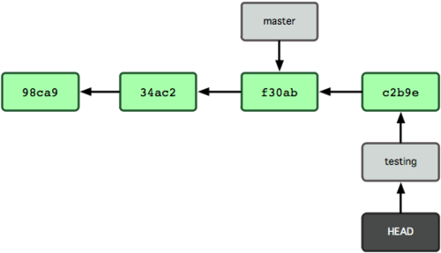
A new commit is made to “Active” branch

Slide 19
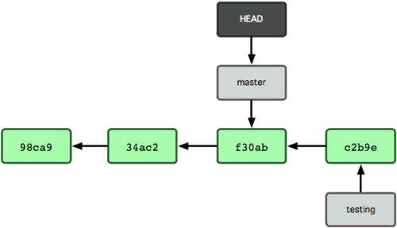
“master” is now active branch

Slide 20
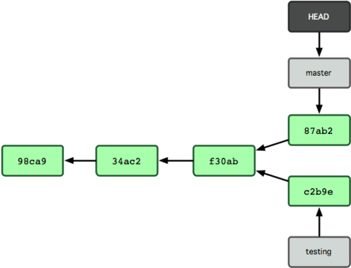
A new commit is made to “Active” branch

Slide 21
Demo of Branching
Showing all branches
git branch
Creating a new branch
git branch <name>
Making a branch as current branch
git checkout <branchname>
Merge branches with Active branch
git merge <branch1> <branch2>…
Stashing
git stash
git stash pop
git stash drop
Creating a file
touch <filename>

Slide 22
Introduction to GitHub.com
GitHub is a Web-based Git version control repository hosting service.
It also provides many other collaboration features such as bug tracking, features request, task management, wikis etc.
Private & Public Repositories
Other such hosting services
Bitbucket.com
Gitlab.com
You may have your own git Server for repositories management

Slide 23
Remote Repository
Repository version on server.
Quick Workflow:
Step 1: Clone the repository from Server
Step 2: Make local commits, create branches (if required) etc.
Step 3: Pull/Fetch Changes from Server, Merge changes with your local changes (if any)
Step 4: Push Changes to Remote Repository.
Step 5: Repeat from Step 2

Slide 24
Remote Tracking Branches
Branches on Remote Servers
master
mybranch
Remote Branches on Local Repository
origin/master
origin/mybranch
Local Branches
master
mybranch
mybranch2

Slide 25
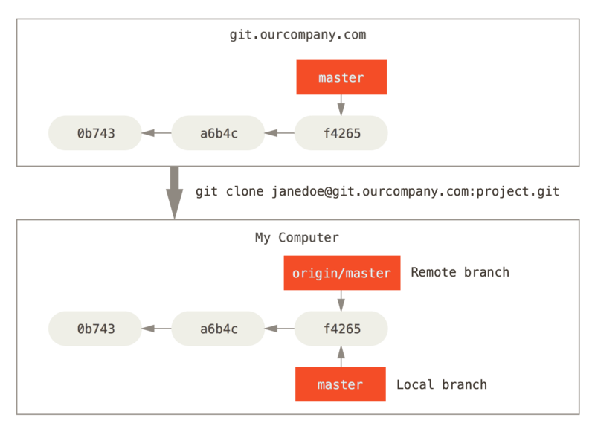
Server and local repositories after cloning
Notes:
https://git-scm.com/book/en/v2/Git-Branching-Remote-Branches

Slide 26
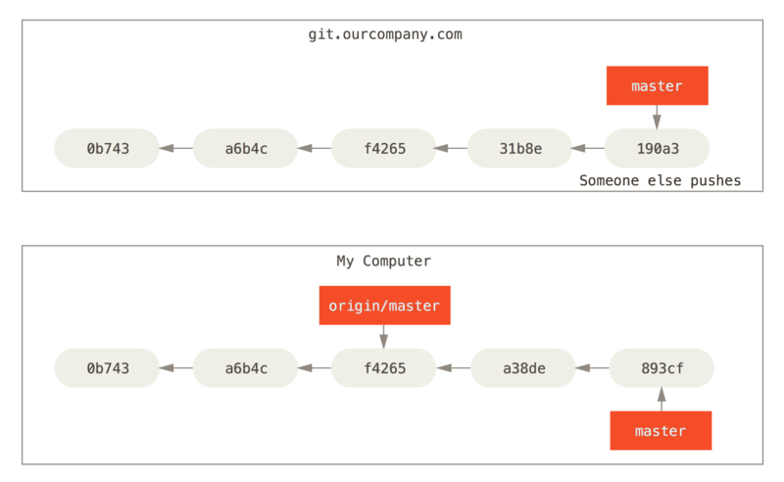
Local and remote work can diverge
Notes:
https://git-scm.com/book/en/v2/Git-Branching-Remote-Branches

Slide 27
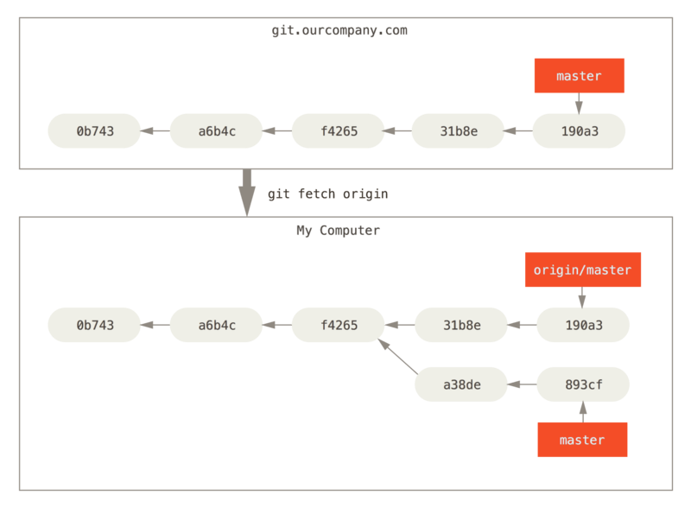
git fetch updates your remote references
Notes:
https://git-scm.com/book/en/v2/Git-Branching-Remote-Branches

Slide 28
Remote Repository (contd..)
Clone a remote repository to local folder
git clone <repository url>
It will copy whole repository with all commit history, objects, branches etc.
Name of branches will be “remote/branchname”. Here “remote” is name of your URL. “origin” is default “remote” name. But you can edit it.
Get Changes from Server (with merge)
git pull
git pull <originName> <branchName>
Get Changes from Server (without merge)
git fetch
git fetch <originName> <branchName>
Push changes to server
git push
git push <originName> <branchName>
Checkout a branch
git checkout <branchName>
will try to find unique branch name from remote branches
git checkout -b <name> <remoteURLName>/<branch>
Will create a local branch against remote branch

Slide 29
Demo 1
Create a new repository on GitHub
Clone the repository
Case 1: Local Changes
Make some local commits
Push Changes to Server
Merge will be fast forward (No new commit will be created for merge)
Case 2: Remote repo is changed after your clone/pull. (No conflict)
Make some local commit
Make some commit on remote repo directly
Try to push your local commits to server. You will have to pull remote changes first.

Slide 30
Demo 1 (cont…)
Case 3: Remote repo is changed after your clone/pull. (Conflict is occurred)
Make some local commit
Make some commit on remote repo directly
Try to push your local commits to server. You will have to pull remote changes first.
Auto Merge will be failed because of conflicts.
You will resolve conflict manually. Will make a merge commit and PUSH your changes.

Slide 31
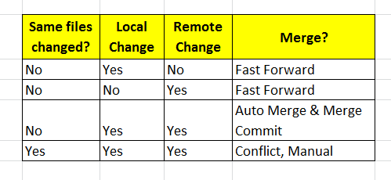
Demo 1 (cont…)

Slide 32
Demo 2
Create branch on Remote
Pull Changes
Switch to new branch
Make a commit & Push
Create Local branch
Make a commit and push

Slide 33
GUI Tools for git
https://git-scm.com/download/gui/windows
SourceTree
GitHubDesktop
TortoiseGit
Git Extensions

Slide 34
Installation of TortoiseGit
Download
https://tortoisegit.org/download/
Install

Slide 35
TortoiseGit – Demo 1
Clone Repository
Push changes
Pull changes
Fast Forward Merge
Merge without conflict case
Merge with conflict case
Show Log
Git Ignore

Slide 36
TortoiseGit – Demo 2
Git Sync dialogue
Creating a Branch
Checkout a Branch
Merging two branches
Change in one branch only
Changes on both branches (without conflict)
Changes on both branches (with a conflict)
Remote branches

Slide 37
Using Git with Visual Studio
Commit Changes
Undo Changes
Push/Pull/Synch changes
Create Branch
Merge Branch
Gitignore

Slide 38
Quiz
What is Stashing?
How do you delete a commit?
How do you delete a branch?
How do you store your credentials?
How do you set your username & email for a repository only?
What is detached head?
How to checkout a specific commit?
What are tags in git?

Slide 39
Git Remote – Demo 3
Create Remote Repository
Create Local Repository
Add Remote detail in Local repository
git remote add myorigin <giturl>
Note: This doesn’t set branch tracking.
Fetch repository data
git fetch myorigin
Enable Branch tracking: Checkout master branch against remote
git checkout -b master myorigin/master
git checkout master
Make some commits
Push Changes to Server

Slide 40
References
https://git-scm.com/book/en/v1

Slide 41
Thank You

